Slide 1


Slide 2
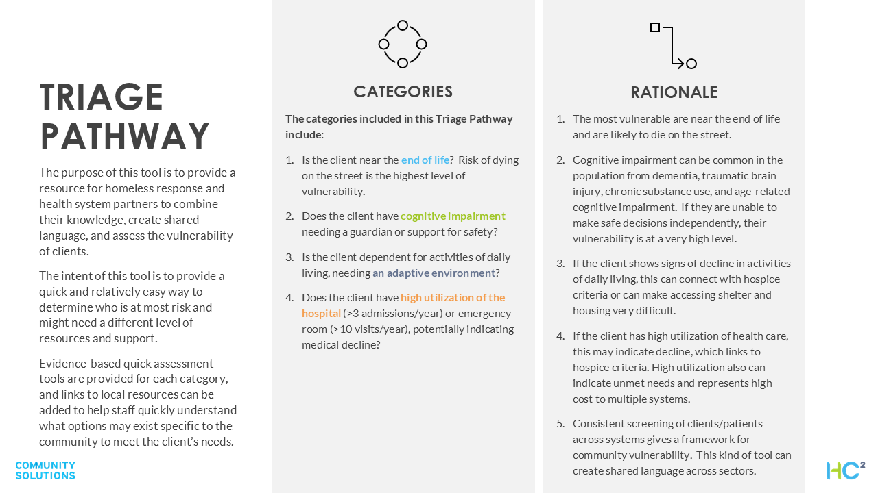

Slide 3



TRIAGE PATHWAY
End of Life?
Cognitive Impairment?
Adaptive Environment Needs?
High Health Care Utilizer?
Does the client have: Weight loss >10% Change in memory/confusion Unstable medical conditions Frequent hospitalizations PPS score less than 70% IF YES, prioritize for highest level of action: Refer to hospice or a medical provider for assessment Discuss client wishes Identify a decision maker Consider hospice residence or long-term care with hospice for housing options IF NO, evaluate for cognitive impairment. Hospice resources in our community: |  | Does the client have: Change in memory/ confusion Trouble with word finding Getting lost Change/decline in ADLs Free training IF YES, prioritize for second-highest level of action: Complete a MOCA screen (free training resource). If positive go to next step Refer to a clinical partner for competency assessment Identify a decision maker or potential Conservatorship Discuss client wishes Consider memory care for additional housing options IF NO, evaluate for adaptive environment needs. Memory care resources in our community: |  | Does the client need: Wheelchair access? Help to walk up stairs (or are they unable to)? Oxygen? Help with toileting or incontinence? IF YES, prioritize for third highest level of action: Assess status Discuss client wishes Consider older adult services for support IF NO, evaluate for high health care utilization. Supportive environment resources in our community: |  | Is the client visiting the hospital emergency department more than 10 times a year or staying in the hospital more than three times a year? IF YES, prioritize for fourth-highest level of action: Consider if the patient qualifies for hospice Consider the root cause driving the utilization and address it Engage in cross-sector case conference with hospital/s Consider hospital resources for accessing outlier options for housing (i.e., paid board and care for housing)

